Slide 1

A Guide for, Early Teens’ Development
Understanding anatomical developments across genders
And understanding their rights regarding Gender based violence

Slide 2

OBJECTIVE:
Early Teen Development - a challenging subject to approach, leaving a pure life & understanding foundation of anatomical development
Goals:
Enable parents to have open communication with teens regarding the anatomy of an early age.
This will drive improvement
Reducing teen pregnancy
Reducing Gender based violence
Enable self respect, Righteous living & Social responsibility
Drives open communication & diversity within cultures & Religious groups
Enables teenage self empowerment, mental & physical wellbeing & Avoid peer pressure
Provide an empowerment tool for schools to openly communicate to teens and parents.
Enable teens to explore & understand their body

Slide 3







WHERE OUR CHILDREN LEARN ABOUT SEXUALITY
Movies
Online pornography
Social media
Music with profane lyrics
Ill-informed siblings
Sexuality is distorted and glamourized
Women are portrayed as sex objects
Children cannot determine what is real and what is not
95%
The percentage of children who access the internet regularly in South Africa
INTERNET USE
Unicef SA Online kids study2021

Slide 4


The CONTEXT in SOUTH AFRICA
ALARMING STATISTICS
Teenage pregnancy rate 1 in 4 girls fall pregnant before the age of 20
SA has highest HIV Rate in the world 13.71% of our population
HIV 33.1% of all women aged 18 years & older have experienced gender based violence
National Overview
Over 90,000 School girls became pregnant in 2023, with some as young as 10 year old.
On average, 365 teenagers give birth everyday, and 10 of those are under 14.
In the 2023/24 financial year, nearly 120,000 girls aged 15-19 gave birth, along with 2,700 girls aged 10-14
The NEED for guidance:
Reduce:
Teenage Pregnancy
Gender based violence
HIV/AIDS spread or STD’s
Depression & mental impact from lack of understanding / Awareness
Promote :
Awareness of self respect
Righteous living & social Responsibility
Education and reduction of further hindering unemployment rate in SA across all genders.
Informing children about sexuality and giving them a consistent moral basis to guide them and to live by has never been more crucial.

Slide 5
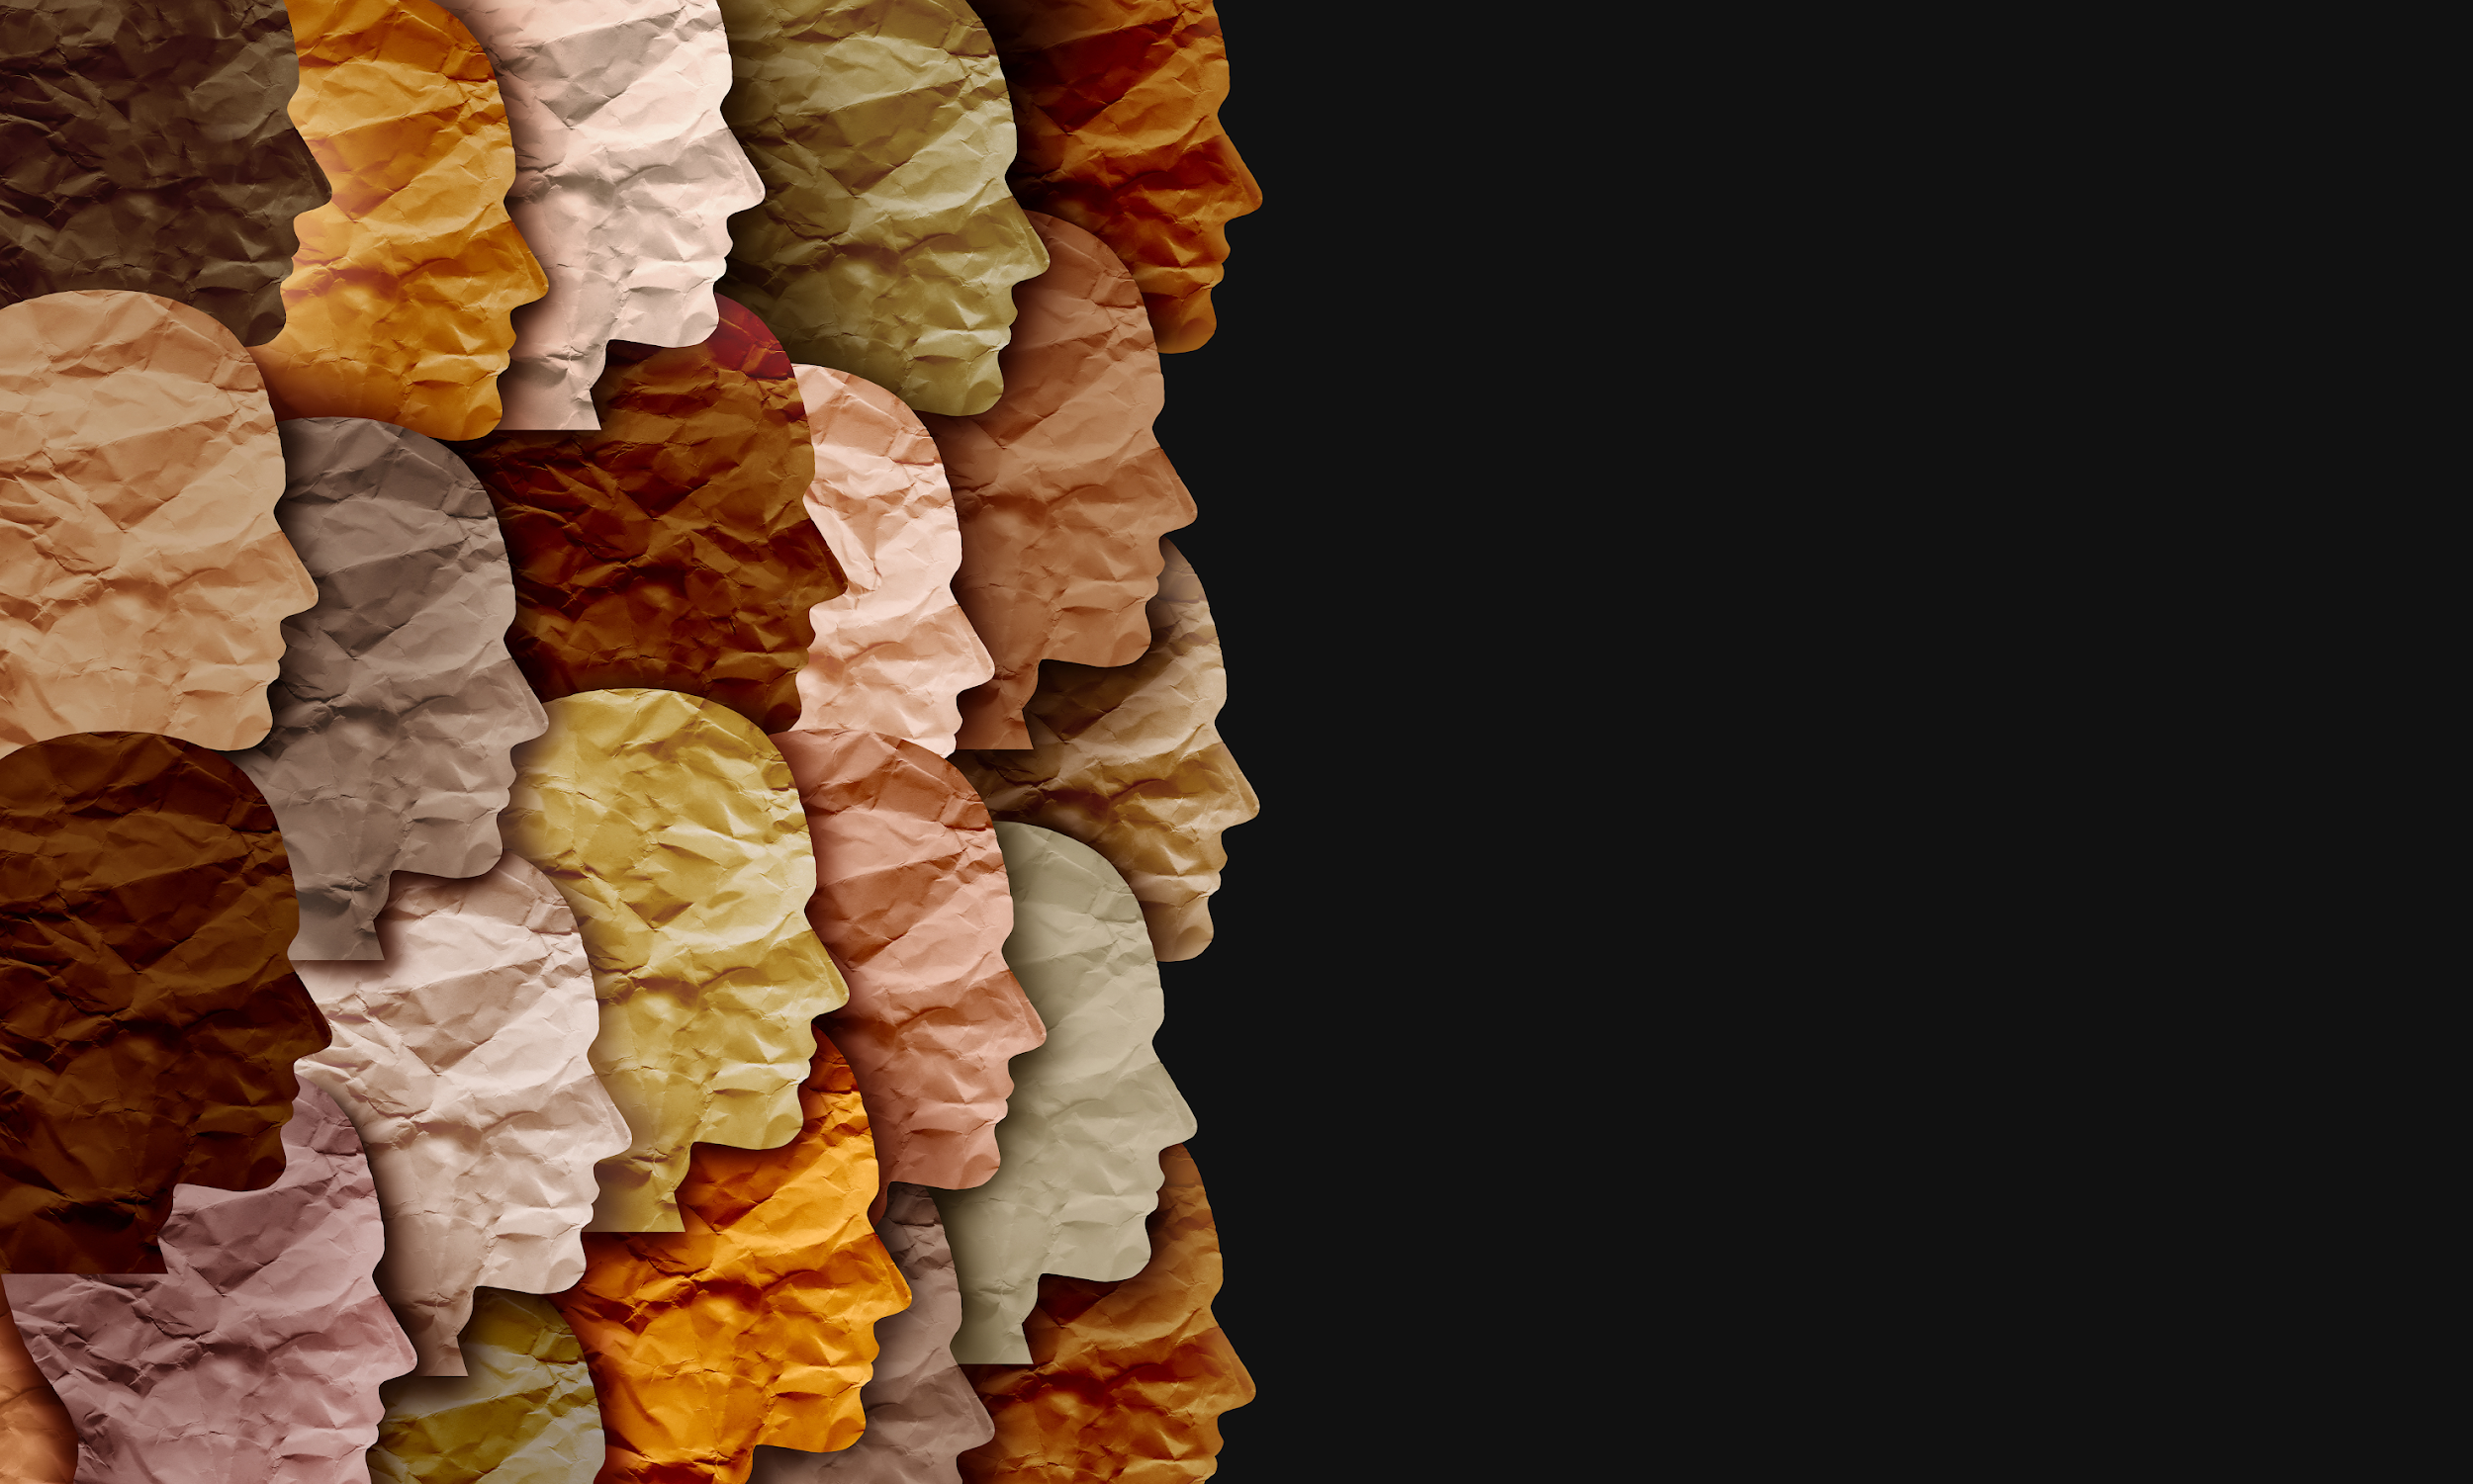

An alternative approach can help break the cycle
South African society is diverse and challenging
Multiple cultures, beliefs, economic situations, and family structures
The CONTEXT in
SOUTH AFRICA
Create devastating consequences teenage pregnancy, sexual violence and pornography addiction.
Broken families, absent fathers due to divorce, death or work.
Children experiment and do unguided self research.
Children lack parental guidance or involvement

Slide 6
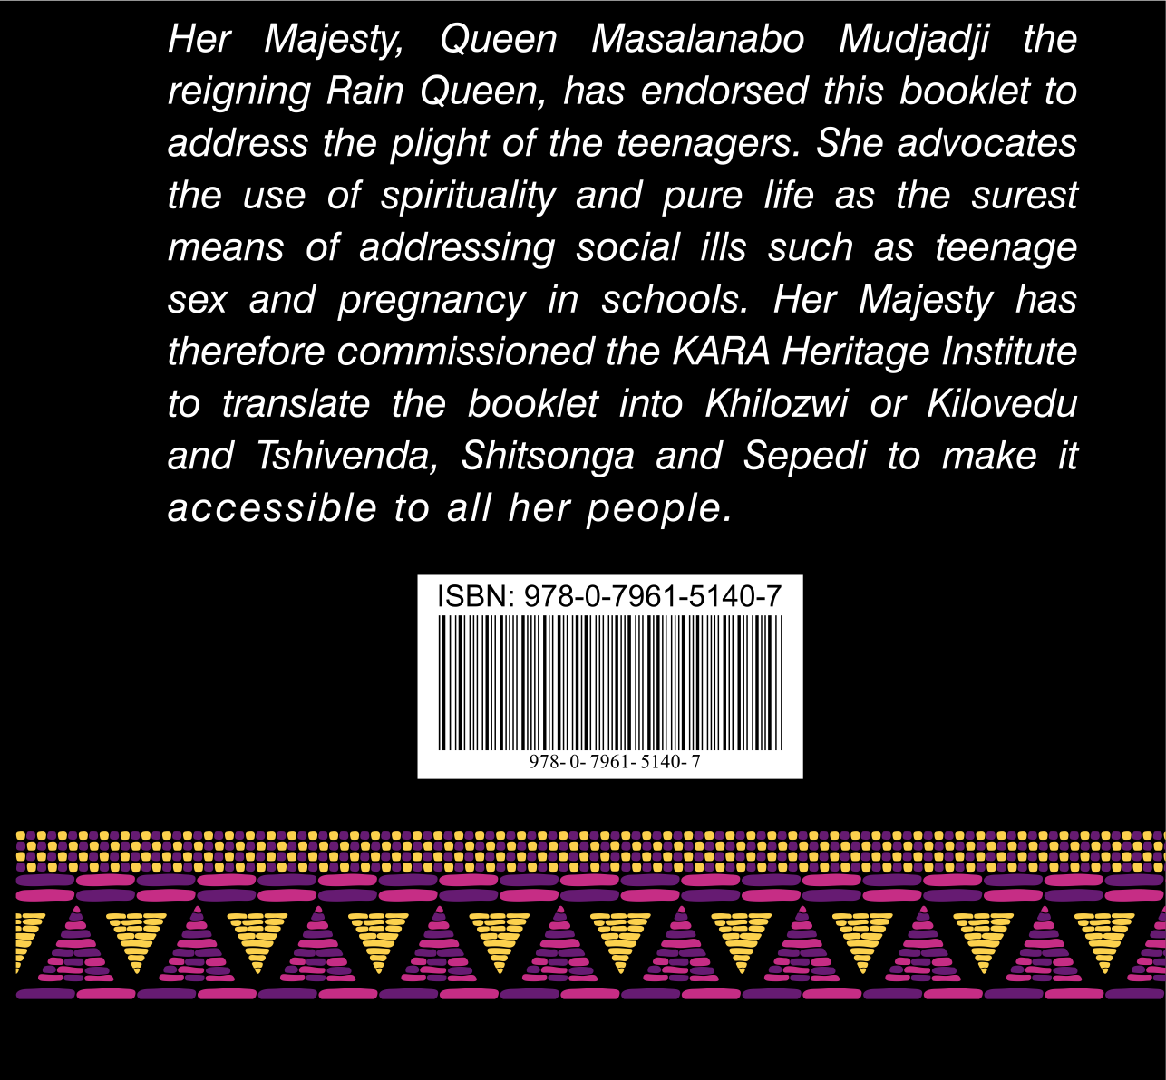
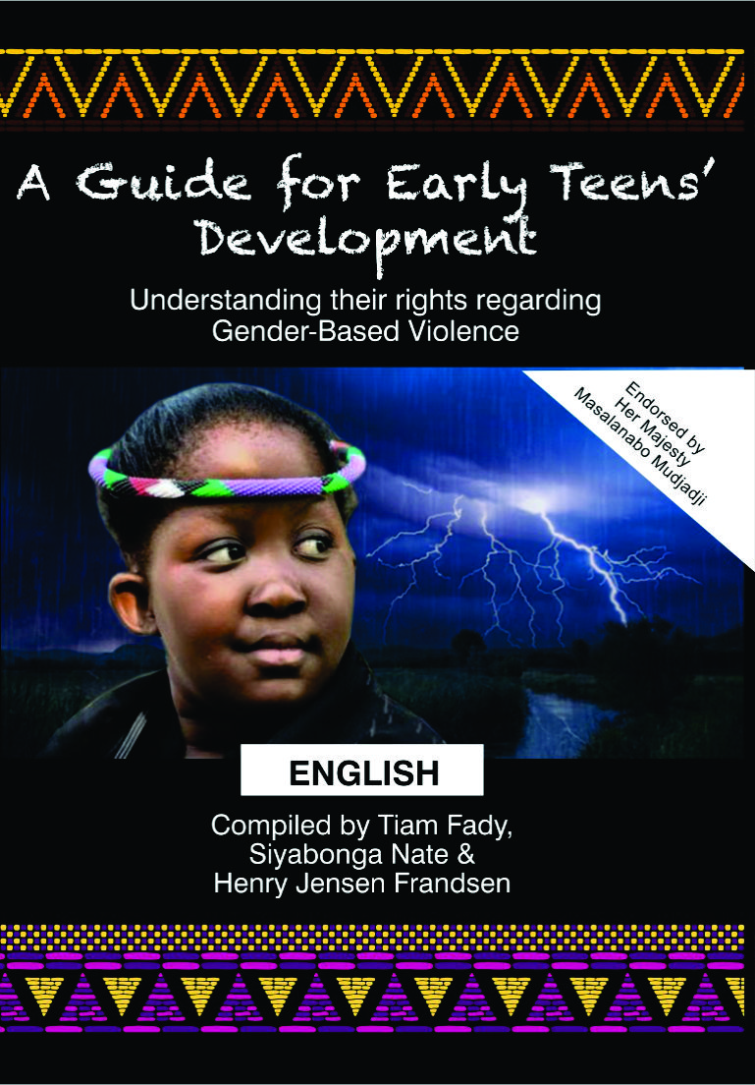
AN ENDORSEMENT FROM HER MAJESTY QUEEN
MASALANABO MUDJADJI “THE RAIN QUEEN”

Slide 7
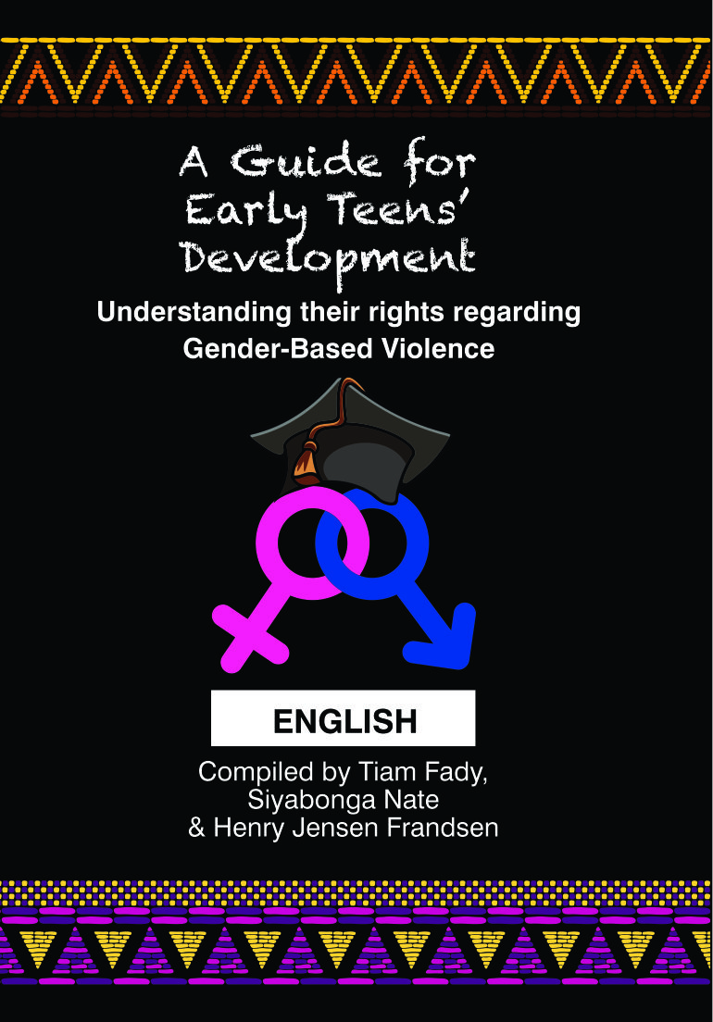
A Guide for Early Teens’
Understanding their rights regarding Gender-based Violence
Available in all languages

Slide 8

Chapter breakdown of A Guide for Early Teens’ Development
Chapter 1
Sexuality in Humans
Exploring the sexual instinct, stimulus versus response, how sexuality can be controlled and its original purpose. Sexuality in relation to the human personality
Chapter 2
Exploring the reproductive organs and their function as well as secondary characteristics
Reproductive Organs
and their function
Chapter 3
The mind, emotions and instincts placed in the correct order, how each interact and how they affect our decisions about sexuality.
The role of sexuality
In human life
Chapter 4
Exploring the struggle within each child as they come to terms with sexuality, the concept of chastity as a strength and why purity is possible
Refraining from sex
Is a strength not a weakness

Slide 9
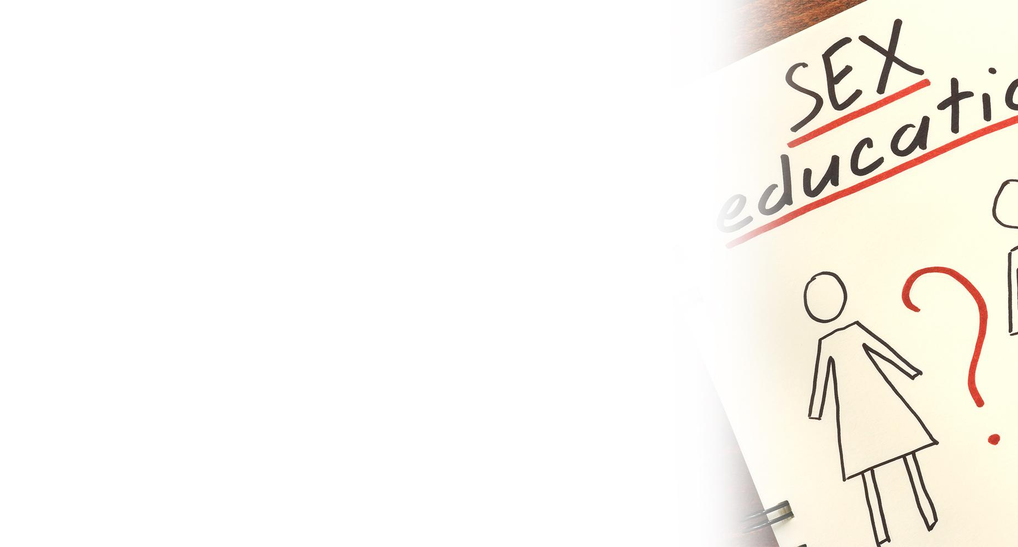
Chapter breakdown of A Guide for Early Teens’ Development
Chapter 5
How to deal with the idea of keeping yourself pure in a society that is designed to corrupt you by changing attitudes towards sex. What to do about the sexual energy of adolescents.
The Life of Purity during
Adolescence
Chapter 6
How to Live a Pure Life
How to conquer attacks against a life of purity and avoiding temptation. A helpful plan to stay pure.
Chapter 7
The Opposite Sex
Dealing with attraction whilst getting to know the opposite sex. The nature of boys versus the nature of girls and how they are different.
Chapter 8
How to honour your body and how modesty can be used as a powerful weapon in eliminating lust and exercising self control.
Modesty versus Promiscuity

Slide 10

Refraining from sex is a strength not a weakness
Your ability to refrain from sexual activities, is a strength not a weakness.
Exploring the struggle of avoiding bad thoughts about sexuality and sex and solutions to remaining pure
Why chastity is a strength and not a weakness
Sexuality as a gift created within us
The dangers of seeking knowledge from bad sources at school, on the street among friends and on the internet
How texting and sharing pictures of your body may seriously harm you.
Why purity is not only possible, but the natural way things should be.

Slide 11

How to Live a Pure Life
How can I live a pure life?
How can I conquer the attacks against my purity through inner strength and pure thought life?
Helpful tips to help win the war against our minds by developing inner weapons
First defense-Preserving our senses by expelling bad thoughts.
Guarding our senses so that they do not lead us to bad thoughts. The eyes, our hearing and our touch.
Choosing our friends wisely so that we do not corrupt good habits.
Developing an offensive plan with a positive approach.

Slide 12
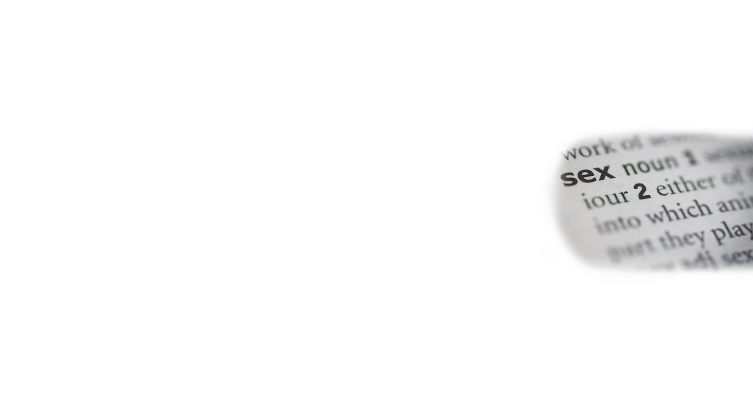
Helpful guide for Teachers and Parents
How to deliver this message
Teachers and parents can use this book as a guide:
An individual method of Teacher or Parental support:
Giving clear adequate answers and if necessary gradual explanations on a one-on-one basis.
Teaching groups:
This guide can be taught by presenting some guidelines in
a gradual and discreet way covering each subject as a group.
It is necessary for this age group to read this book, as some of these children could already be experimenting in sexual activity.
This guidance could possibly save them from destroying their reputation and even avoid pregnancy.
The book itself contains more guidelines as to how to get the most out of the book.

Slide 13
Conclusion
As authors we are aware that there are different approaches to delivering sex education to teenagers. We are also aware that this book does not cover the questions relating to LGBTQ+. We believe that that subject is worthy of another book and is therefore not covered in this manuscript.
It is our belief that seeking purity is an alternative approach built in traditional cultures that comprise our South African community and therefore we believe strongly in it as a basis for sex education. Whoever speedily obtains purity, progresses in their spiritual and social lives, enjoying healthy minds and souls, maintaining stable and successful personalities.

Slide 14
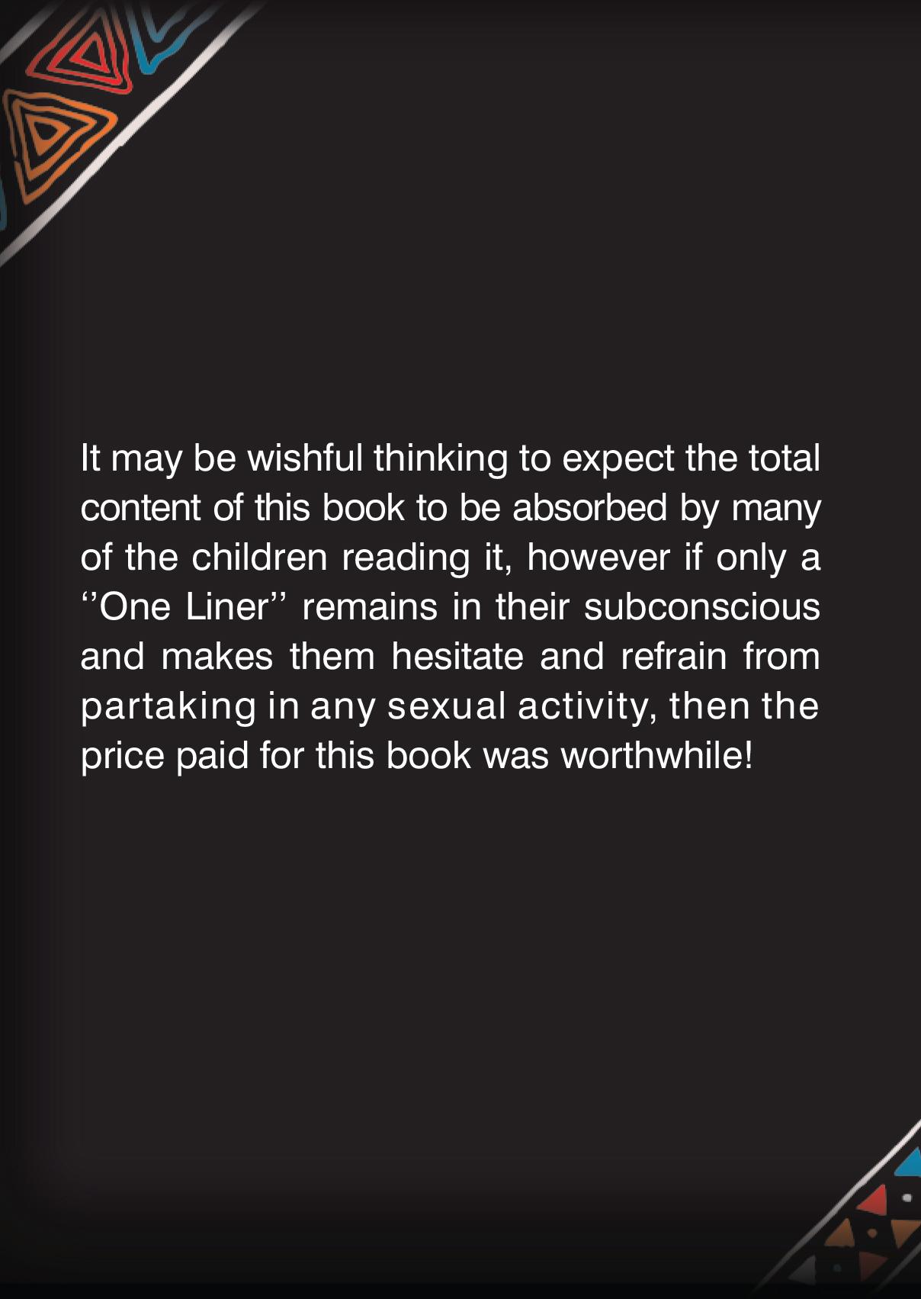
Closing thought…

